Slide 1
PART 3
ELECTRIC VEHICLE PRICES IN THE U.S. MARKET

Slide 2
GOALS:
Identify what are the main performance indicators that users look for when buying an EV.
Determine which performance indicator has the strongest influence in the end price.
Develop a method for raking of EV currently available in the US market.
Develop a tool for forecasting the EV price based on performance indicators.

Slide 3
3.1 THE DATA

Slide 4
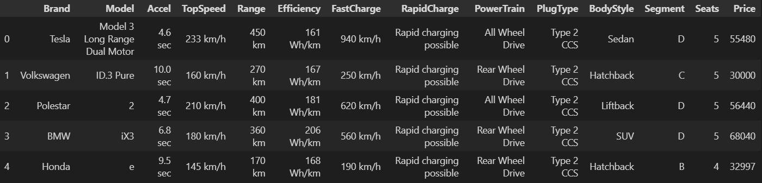
3.1 THE DATA
METRICS:
BRAND/MODEL
QUANTITATIVE METRICS
QUALITATIVE METRICS
PRICE
Source: US Department of Energy, International Energy Agency, Statista
Format: .csv file
Size: 103 rows x 14 columns

Slide 5
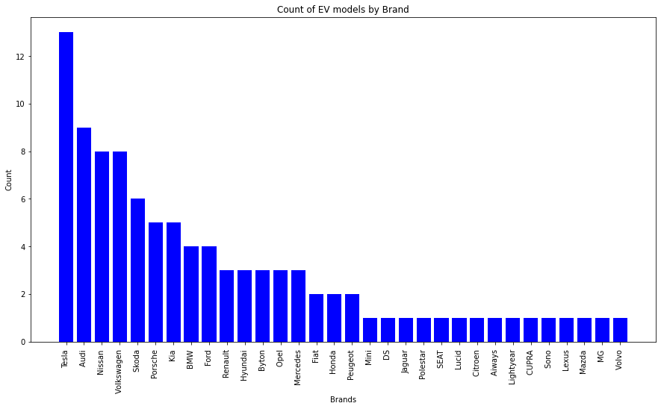
3.1 THE DATA
BRAND/MODEL:

Slide 6
3.1 THE DATA
METRICS:
BRAND/MODEL
QUANTITATIVE METRICS
QUALITATIVE METRICS
PRICE
Source: US Department of Energy, International Energy Agency, Statista
Format: .csv file
Size: 103 rows x 14 columns

Slide 7
QUANTITATIVE METRICS:
3.1 THE DATA
Acceleration Time (secs): Time needed to accelerate from 0 km/h to 100km/h
Top Speed (km/h): Maximum speed achieved by a car
Range (km): Maximum distance a vehicle can cover on one full charge
Efficiency (Wh/km): Energy in watt-hour spent after driving 1km
Fast Charge (km/h): Driving range added per hour of charge

Slide 8
3.1 THE DATA
METRICS:
BRAND/MODEL
QUANTITATIVE METRICS
QUALITATIVE METRICS
PRICE
Source: US Department of Energy, International Energy Agency, Statista
Format: .csv file
Size: 103 rows x 14 columns

Slide 9
QUALITATIVE METRICS:
3.1 THE DATA
Powertrain: System that transfer energy from a car’s engine to the wheels
Plug Type: Type of connector used to connect the vehicle to a charging station
Body Style: Type/design of the vehicle’s body or exterior
Segment: Class/category based on the size and use of the vehicle

Slide 10
3.1 THE DATA
METRICS:
BRAND/MODEL
QUANTITATIVE METRICS
QUALITATIVE METRICS
PRICE
Source: US Department of Energy, International Energy Agency, Statista
Format: .csv file
Size: 103 rows x 14 columns

Slide 11
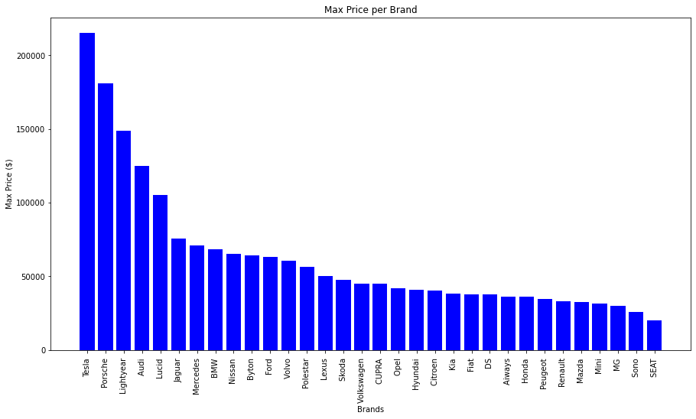
3.1 THE DATA
PRICE:

Slide 12
3.2 ANALYISIS OF QUALITATIVE METRICS

Slide 13
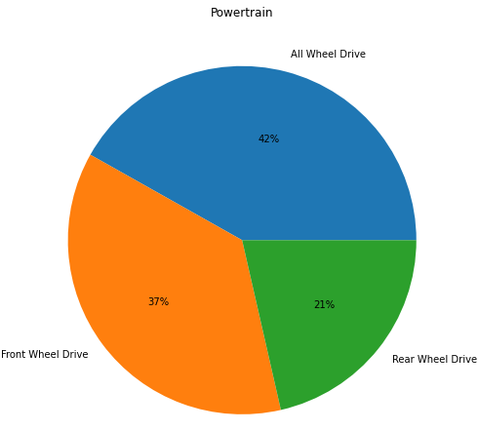
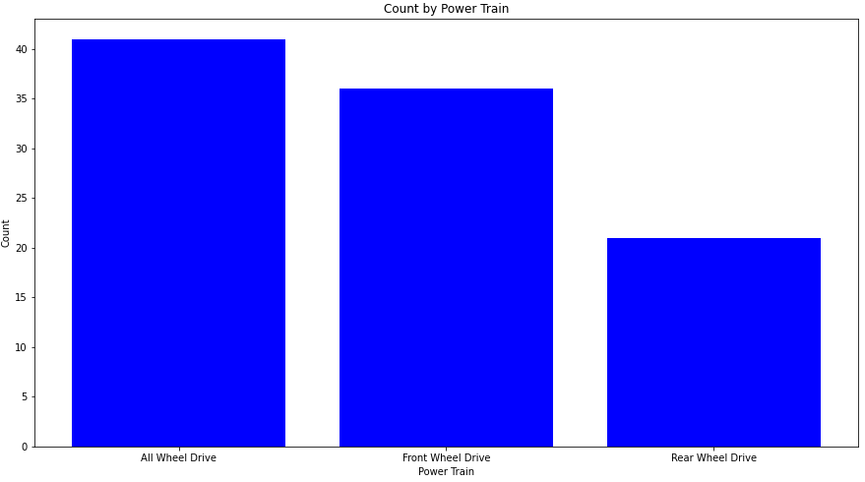
3.2 ANALYSIS OF QUALITATIVE METRICS
POWER TRAIN
PLUG TYPE
BODY STYLE
SEGMENT

Slide 14
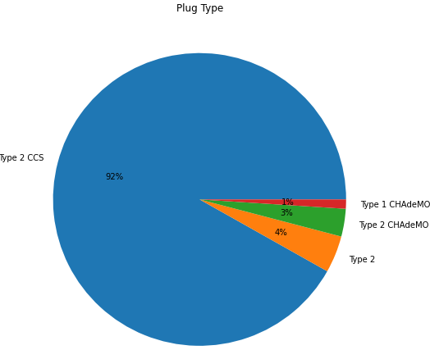
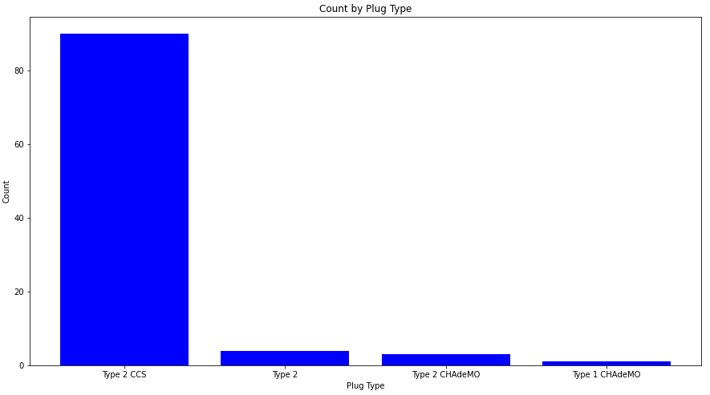
3.2 ANALYSIS OF QUALITATIVE METRICS
POWER TRAIN
PLUG TYPE
BODY STYLE
SEGMENT

Slide 15
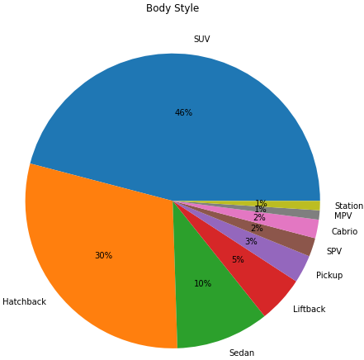
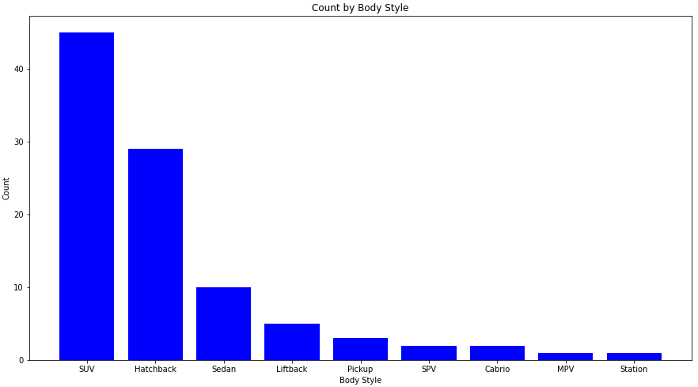
3.2 ANALYSIS OF QUALITATIVE METRICS
POWER TRAIN
PLUG TYPE
BODY STYLE
SEGMENT

Slide 16
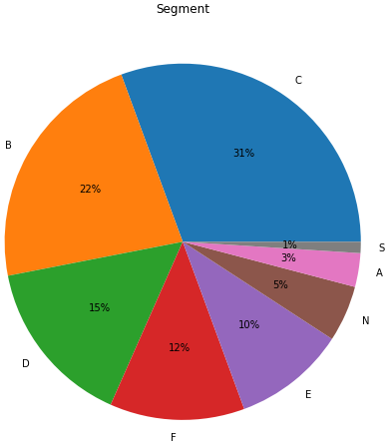
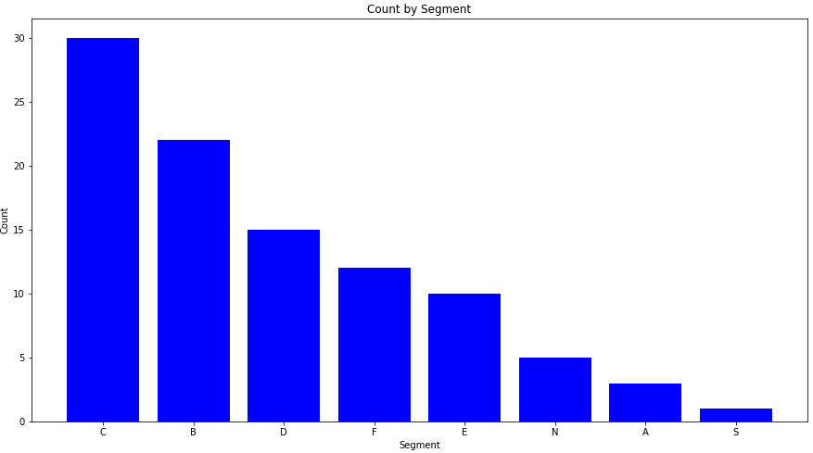
3.2 ANALYSIS OF QUALITATIVE METRICS
POWER TRAIN
PLUG TYPE
BODY STYLE
SEGMENT

Slide 17
3.3 ANALYISIS OF QUANTITATIVE METRICS

Slide 18
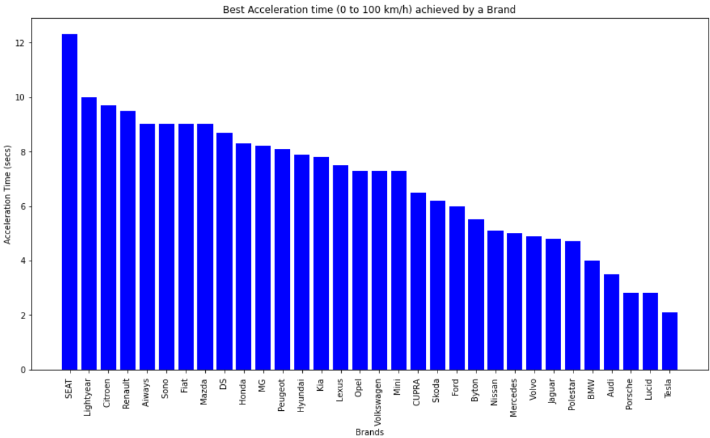
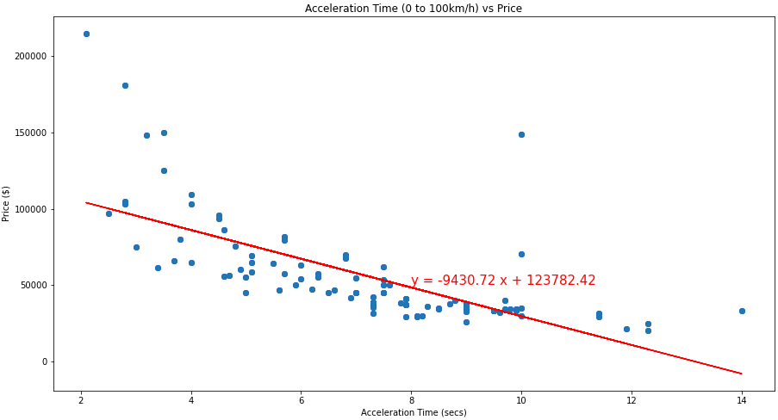
3.3 ANALYSIS OF QUANTITATIVE METRICS
ACCELERATIONTIME
TOP SPEED
RANGE
EFFICIENCY
FAST SPEED
The acceleration time shows a moderate negative relationship with prices, with an r-value of -0.68 for the linear bet-fit regression line.

Slide 19
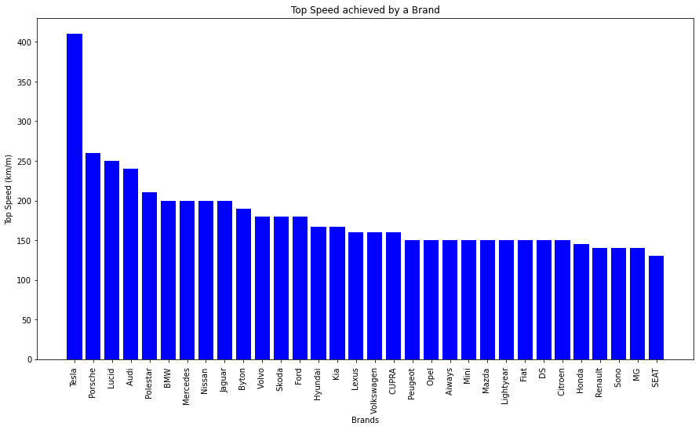
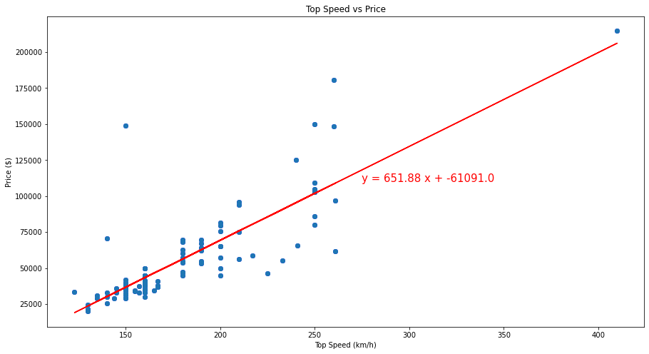
3.3 ANALYSIS OF QUANTITATIVE METRICS
ACCELERATIONTIME
TOP SPEED
RANGE
EFFICIENCY
FAST SPEED
The top speed shows a strong positive relationship with prices, with an r-value of 0.82 for the linear bet-fit regression line.

Slide 20
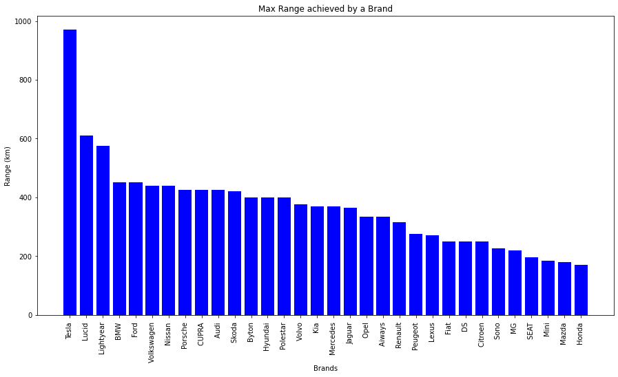
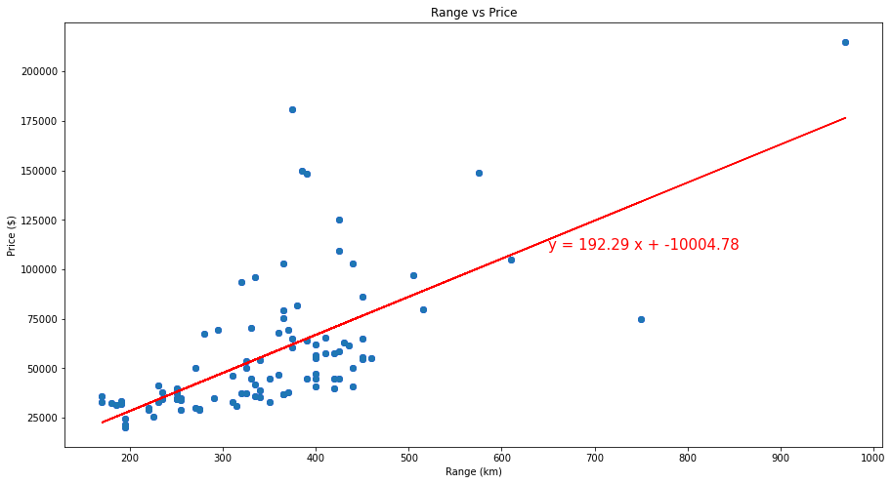
3.3 ANALYSIS OF QUANTITATIVE METRICS
ACCELERATIONTIME
TOP SPEED
RANGE
EFFICIENCY
FAST SPEED
The range shows a moderate positive relationship with prices, with an r-value of 0.66 for the linear bet-fit regression line.

Slide 21
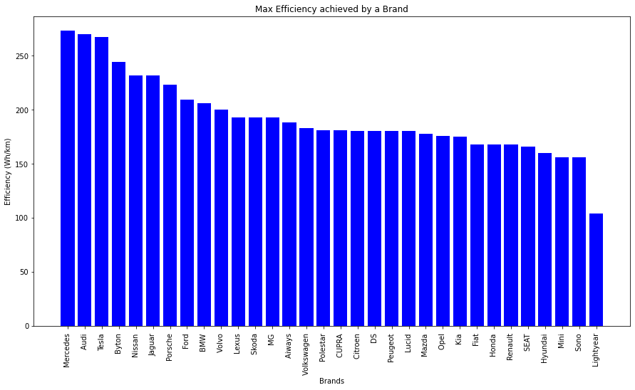
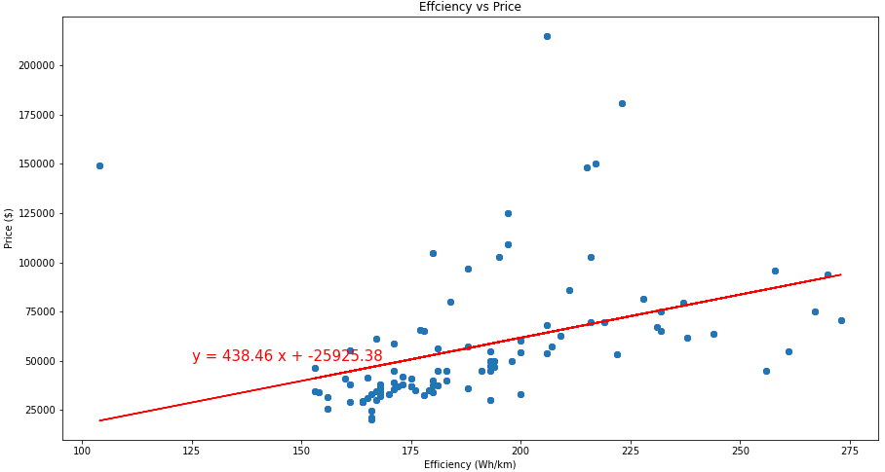
3.3 ANALYSIS OF QUANTITATIVE METRICS
ACCELERATIONTIME
TOP SPEED
RANGE
EFFICIENCY
FAST SPEED
The efficiency shows a weak positive relationship with prices, with an r-value of 0.38 for the linear bet-fit regression line.

Slide 22
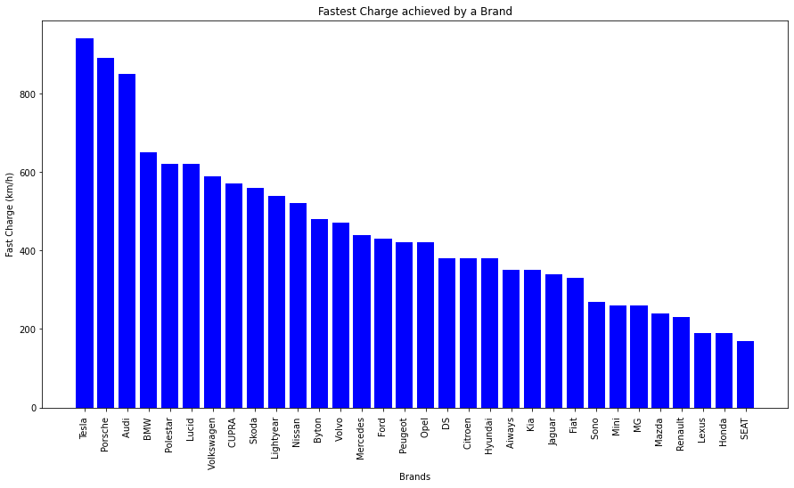
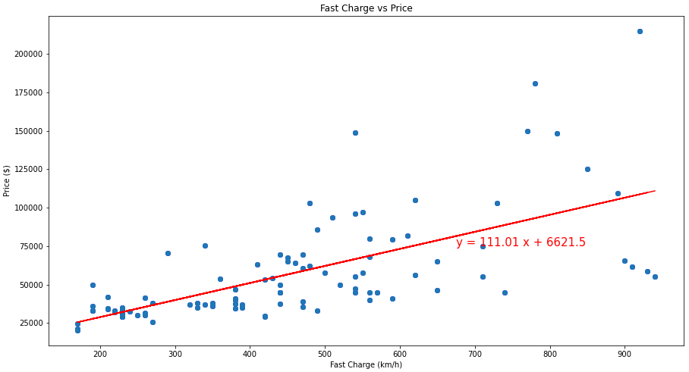
3.3 ANALYSIS OF QUANTITATIVE METRICS
ACCELERATIONTIME
TOP SPEED
RANGE
EFFICIENCY
FAST SPEED
The fast charge shows a moderate positive relationship with prices, with an r-value of 0.65 for the linear bet-fit regression line.

Slide 23
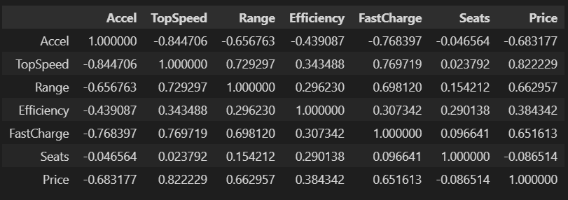
3.3 ANALYSIS OF QUANTITATIVE METRICS
CORRELATION SUMMARY
df.corr()

Slide 24
3.4 TOP SPEED/PRICE VS KEY QUALITATIVE METRICS

Slide 25
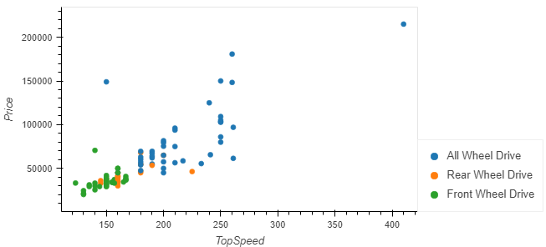
3.4 TOP SPEED VS KEY QUALITATIVE METRICS
TOP SPEED VS PRICE:
POWER TRAIN
BODY STYLE
SEGMENT

Slide 26
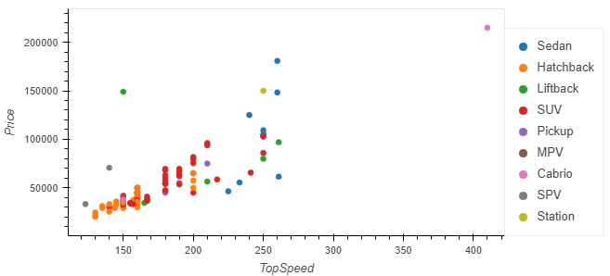
3.4 TOP SPEED VS KEY QUALITATIVE METRICS
TOP SPEED VS PRICE:
POWER TRAIN
BODY STYLE
SEGMENT

Slide 27
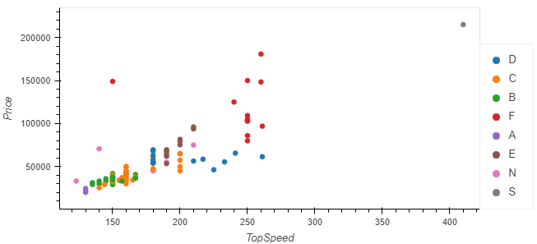
3.4 TOP SPEED VS KEY QUALITATIVE METRICS
TOP SPEED VS PRICE:
POWER TRAIN
BODY STYLE
SEGMENT

Slide 28
3.5 SCORECARD

Slide 29
INSIGHTS:
3.5 SCORECARD
So far…
We have analyzed the EV data set by isolating each metric individually.
We have identified the EV brands that have the best performance for: acceleration time, top speed, range, efficiency, and fast charge.
Next steps…
We will compare the EV brands by considering all the metrics together.
Each EV brand will be assigned an overall score ranging from 0 to 100.
Overall score = Weighted Avg of each quantitative metric performance
Within each metric, the best performance (i.e max top speed, max range, etc.) will be assigned a score of 100. The remaining values will be scaled accordingly.

Slide 30
INSIGHTS:
3.5 SCORECARD
So far…
We have analyzed the EV data set by isolating each metric individually.
We have identified the EV brands that have the best performance for: acceleration time, top speed, range, efficiency, and fast charge.
Next steps…
We will compare the EV brands by considering all the metrics together.
Each EV brand will be assigned an overall score ranging from 0 to 100.
Overall score = Weighted Avg of each quantitative metric performance
Within each metric, the best performance (i.e max top speed, max range, etc.) will be assigned a score of 100. The remaining values will be scaled accordingly.

Slide 31
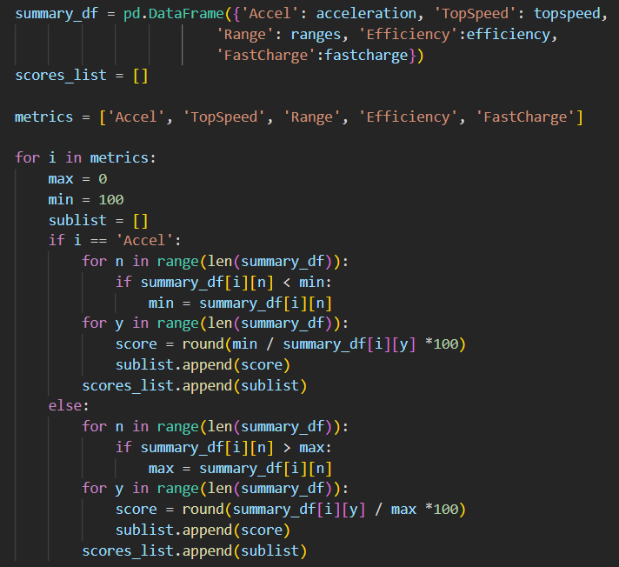
3.5 SCORECARD
SCRIPT:

Slide 32
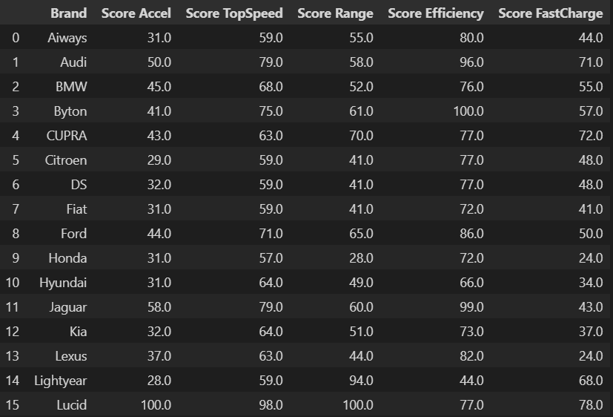
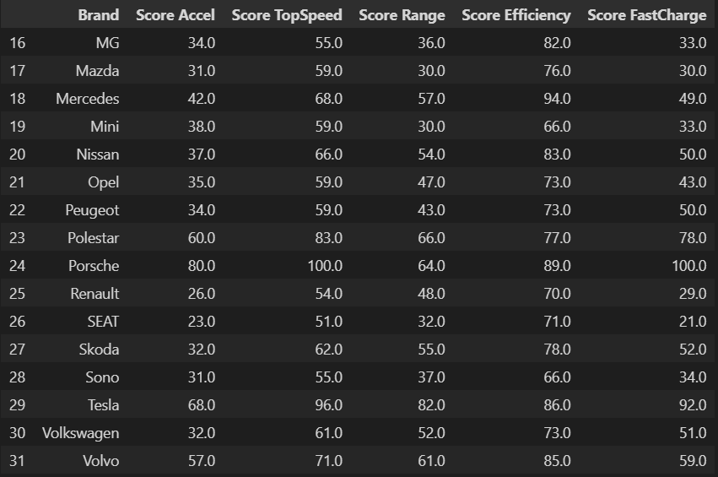
3.5 SCORECARD
METRIC SCORES:

Slide 33
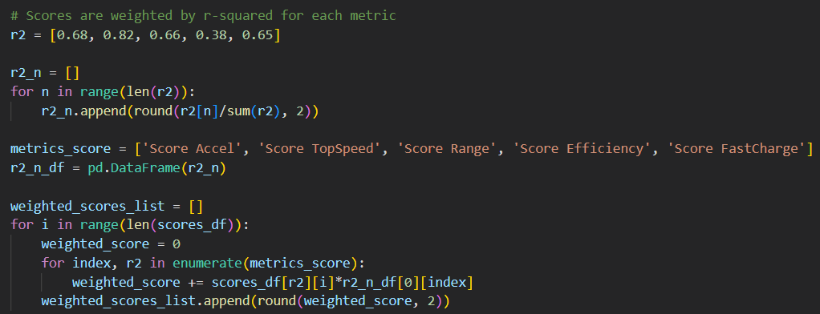
3.5 SCORECARD
OVERALL SCORES:
Overall score: Weighted average by taking into account the r-values for each metric.

Slide 34
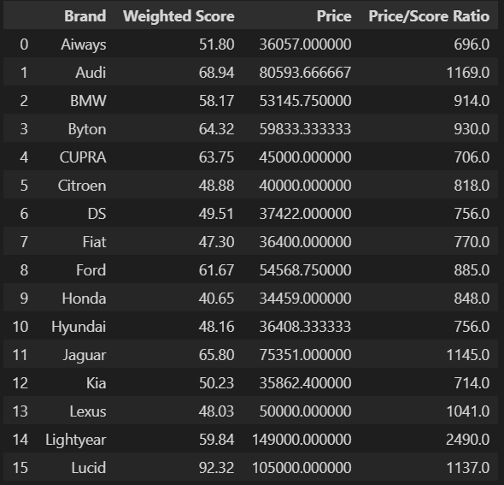
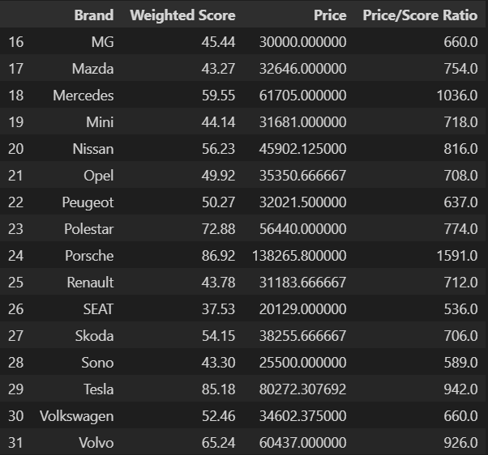
3.5 SCORECARD
OVERAL SCORES:

Slide 35
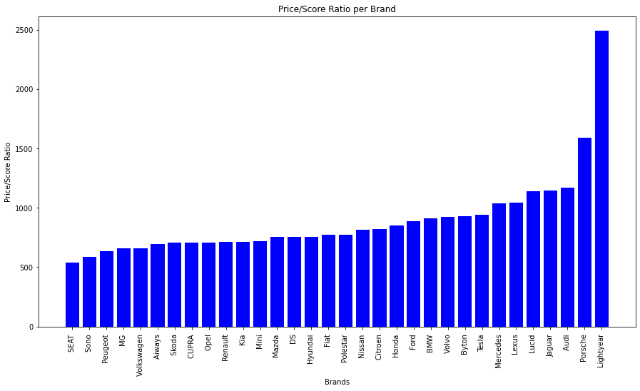
3.6 SCORECARD
Price/Overall Score Ratio

Slide 36
3.6 PREDICTION MODEL: MULTILINEAR REGRESSION

Slide 37
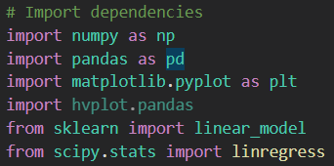
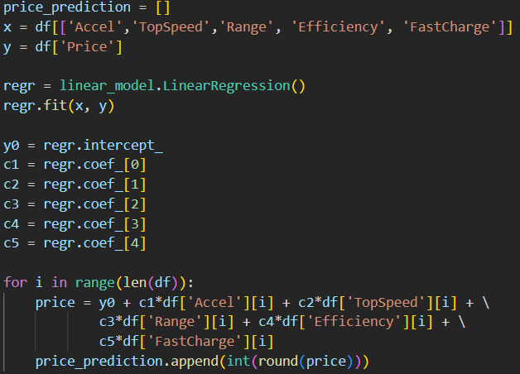
3.6 PREDICTION MODEL: MULTILINEAR REGRESSION
SCRIPT:
Scikit Learn: Machine learning library
X = Independent variables (i.e. acceleration, top speed, range, efficiency, fast charge)
Y = Dependent variable (i.e. Price)
y0, c1, c2, c3, c4, c5 are obtained from linear regression
Price = y0 + c1*X1 + c2*X2 + c3*X4 + c4*X4 + c5*X5

Slide 38
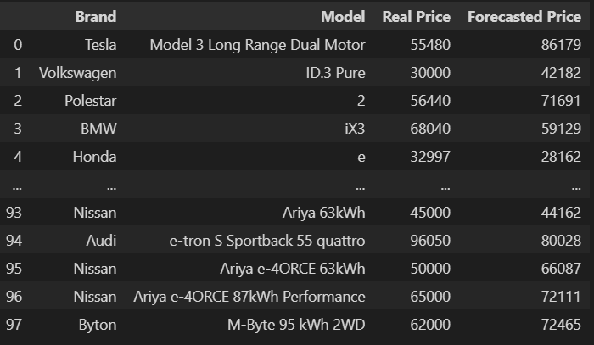
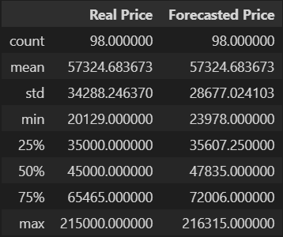
3.6 PREDICTION MODEL: MULTILINEAR REGRESSION
RESULTS:
Real Price vs Forecasted Price
Statistics Summary
The r value is 0.84
84% of the dependent variable has been explained by the independent variables.

